Slide 1


Poornima College of Engineering B. Tech. II Year (III Semester) NSP –I Phase Presentation Session: 2021-22
Project Title: Object Detection Through Deep learning
Submitted By: 3CSC-15
1.Tripti Somani , PCE20CS188, 20EPCCS196
2.Shivam Kumar, PCE20CS175, 20EPCCS177
Project Guide: Mrs. Sonam Gaur
Submitted To: Mrs. Nikita Jain & Mrs. Barkha Narang

Slide 2
TABLE OF CONTENT
LITERATURE REVIEW
COMPARATIVE ANALYSIS
PROBLEM STATEMENT & OBJECTIVE
PROPOSED APPROACH AND DESIGN
DATA COLLECTION AND ANALYSIS
CONCLIUSION AND FUTURE SCOPE
REFRENCES

Slide 3
abstract
Object detection has been a hot topic in the field of research and development for quite a time now. Object detection is any form of signal processing for which the input is an image such as photographs or frame of video, and the output is the detection of a desired object. Object detection stems around the principal application of processing of image data for storage, transmission and representation for autonomous machine perception. In existing system there are many techniques which are available for object detection that we have discussed in detail.

Slide 4
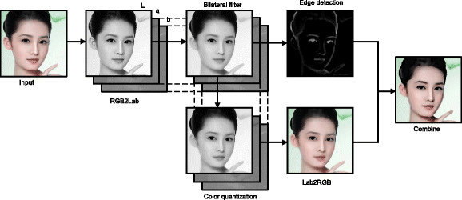
Literature Review
Today every pixel is a data and each frame contains millions of it, but to extract that data and use it for a cause is the real challenge and to overcome this problem we take image processing in use. The various ways which we learned through review paper about how image processing can be done are:
Object Detection Using MATLAB:

Slide 5
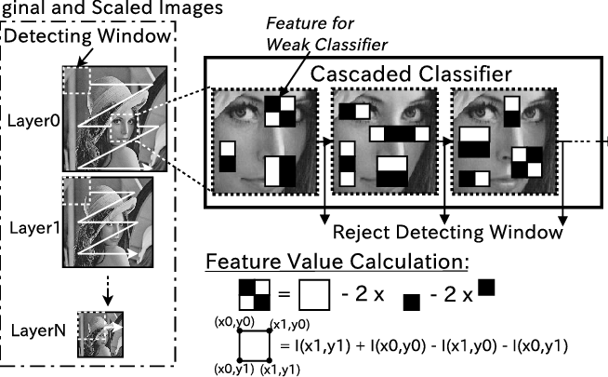
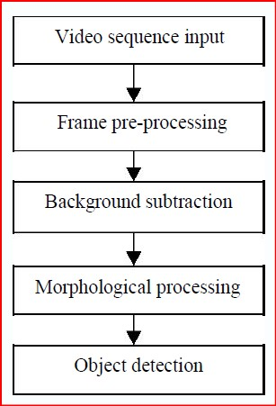
Object Detection using Haar like Features:
Object detection using segmentation & background subtraction:

Slide 6
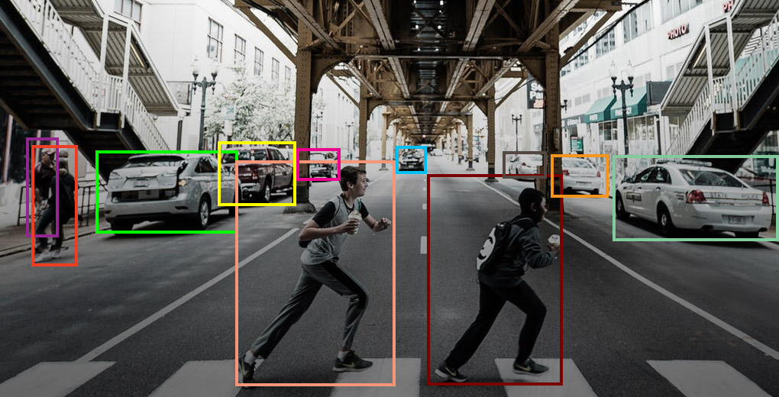
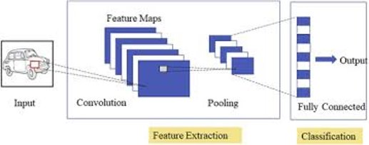
Object Tracking
Object Detection using deep learning

Slide 7
Comparative analysis:
TECHNIQUE | PURPOSE OF METHOD | ADVANTAGE (s) | DISADVANTAGE(S)
[1] OBJECT DETECTION USING HAAR LIKE FEATURES | DETECTING OBJECTS WITHOUT SIZE LIMITATION | HIGH PRECISION OBJECT DETECTION, SPEED DECLERATION. | HIGH ENERGY TRANSMISSION.
[3] OBJECT DETECTION USING MATLAB | DETECTION AND COMPARISON OF IAMGE BY CONVERSION INTO BINARY IMAGE | BUILT IN ALGORITHMS REDUCEC COMPLEXITY AND INCRESES COMPATIBILITY. | IMPLICATION IS SLOW IN COMPARISON TO OPEN CV .
[2] OBJECT DETECTION USING BACKGROUND SUBSTRACTION | DETECTING THE MOVING OBJECT | BANDWIDTH USES REDUCTION | HIGH ENERGY TRANSMISSION.
[6]OBJECT TRACKING | IDENTIFY THE MAIN OBJECT AMONG MANY OBJECTS | Enables Security and surveillance to recognize people also provide better sense of security | Speed, Multiple Scales, Limited data and Class Imbalance.
[4,5&7] Object Detection using DEEP Learning | Real time object detection | Improvements in device capabilities and availability of data | It is extremely expensive to train due to complex data models.

Slide 8
Problem Statement & Objective
We are planning to Develop an Object detection system that will take input from camera and the input frame will be processed using our proposed method and produce a required output. This output will be passed on in the form of voice command which will be achieved by the integration of a voice output unit with our system. This system in the coming future will help visually-aid people to crate an artificial vision and will work like “artificial eyes”.

Slide 9
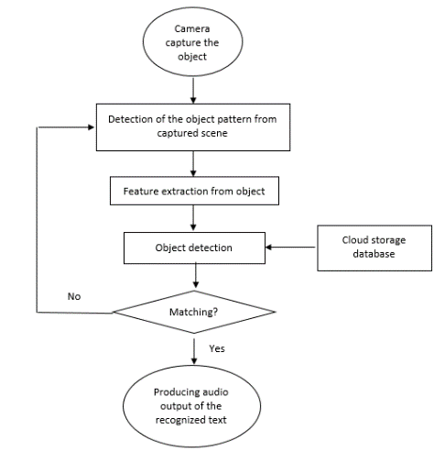
Proposed Approach & Design of Solution

Slide 10
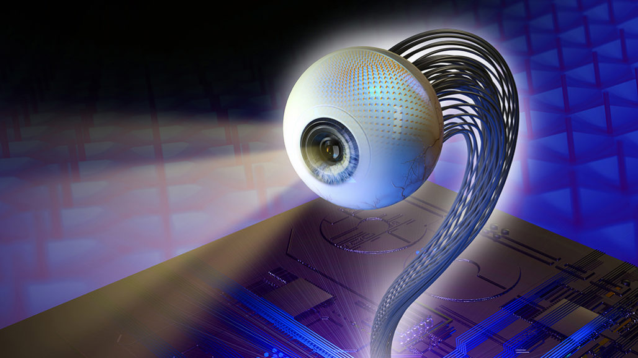
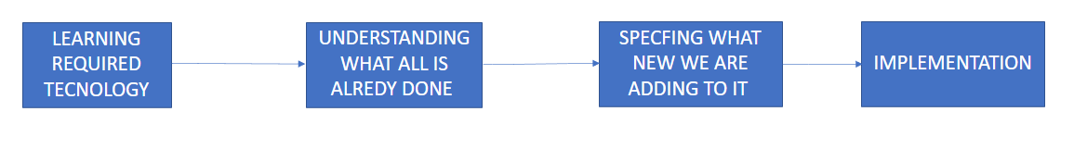
Data Collection & Analysis

Slide 11

Conclusion & Future Scope
Image processing and more specifically object detection is the modern era thing, and in the coming future it will be doing wonders for the world if we look in to the day by day increasing technological advancement we can easily understand that.
If we talk about the future scope Object detection has the potential to free people from menial jobs that can be done more efficiently and effectively by machines.
The future of our project is that we want to become a bliss for the visually aid people.

Slide 12
References
https://www.researchgate.net/publication/310769942_Object_Detection_using_Image_Processing
Video Image Processing for Moving Object Detection and Segmentation using Background Subtraction; 2014 First International Conference on Computational Systems and Communications (ICCSC)
IJERT; Interfacing of MATLAB with Arduino for Object Detection Algorithm Implementation using Serial Communication
Application of Deep Learning for Object Detection; https://creativecommons.org/licenses/by-nc-nd/3.0/
IEEE TRANSACTIONS ON NEURAL NETWORKS, VOL. 10, NO. 3, MAY 1999; Physiologically Motivated Image Fusion for Object Detection using a Pulse Coupled Neural Network
2017 11th International Conference on Intelligent Systems and Control (ISCO); A SURVEY ON MOVING OBJECT TRACKING USING IMAGE PROCESSING
https://doi.org/10.1155/2020/6707328 ; Underwater Image Processing and Object Detection Based on Deep CNN Method
Transformer Transforms Salient & Camouflaged Object Detection; JOURNAL OF LATEX CLASS FILES, VOL. 14, NO. 8, AUGUST 2015

Slide 13
Thanks & QA

